Slide 1
IT Infrastructure Architecture
Infrastructure Building Blocks
and Concepts
Storage – Part 2
(chapter 9)

Slide 2
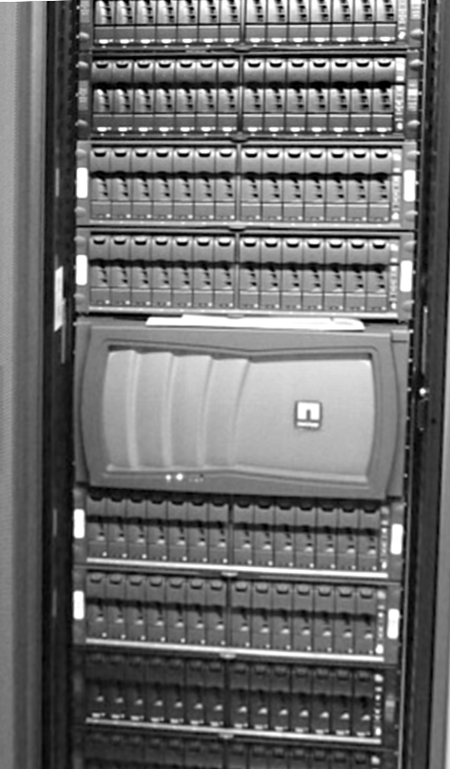
Network Attached Storage (NAS)
A NAS, also known as a File Server, is a network device that provides a shared file system to operating systems over a standard TCP/IP network
NFS (UNIX and Linux)
SMB/CIFS (Windows)
A NAS is often an appliance that implements the file services and holds the disks on which data is stored
A NAS appliance could also use external disk storage provided by a SAN
Can provide snapshot and clone technology at a file level, enabling features like “un-erasing” deleted files by end users

Slide 3
Network Attached Storage (NAS)
The difference between a SAN and NAS:
SAN:
Offers disk blocks (unformatted disks called LUNs) that can be used by only one server
Uses iSCSI, Fibre Channel or FCoE as the communication layer
NAS:
Offers a shared filesystem to store files that can be used by multiple servers
Connects to for instance to an LDAP or Active Directory service in order to set file and/or folder permissions
Uses SMB/CIFS or NFS over TCP/IP as the communication layer

Slide 4
Network Attached Storage (NAS)
A clustered NAS is a NAS that uses a distributed file system running simultaneously on multiple servers
Distributes data and metadata across storage devices
Still provides unified access to the files from any of the cluster nodes, unrelated to the actual location of the data

Slide 5
Object Storage
Object storage is a storage architecture that manages data as objects, where an object is defined as a file with its metadata, and a globally unique identifier called the object ID
Examples of metadata:
Filename
Date and time stamps
Owner
Access permissions
The level of data protection
Replication settings to for instance a different geography
Object storage stores and retrieves data using a REST API over HTTP, served by a webserver, and is designed to be highly scalable

Slide 6
Object Storage
A traditional file system provides a structure that simplifies locating files
For example, a log file is stored in /var/log/proxy/proxy.log
In object storage, a file’s object ID must be administered by the application using it
Using the object ID, the object can be found without knowing the physical location of the data
For example, an application has administered that its log file is stored in object ID 8932189023
Using object IDs enables simplicity and massive scalability of the storage system
The object ID is a link to an object that can be stored anywhere

Slide 7
Object Storage
Data in object storage can’t be modified
The original file must be deleted, and a new file must be created, leading to a new object ID
This makes object storage unsuitable for frequently changing data
It is a good fit for data that doesn't change much, like:
Backups
Archives
Video and audio files
Virtual machine images

Slide 8
Object Storage
Some systems emulate a file system using object storage
For instance, Amazon’s S3FS creates a virtual filesystem, based on S3 object storage, that can be mounted to an operating system in the traditional way, however, with significant performance degradation
A much better solution is to use object storage with applications designed for it

Slide 9
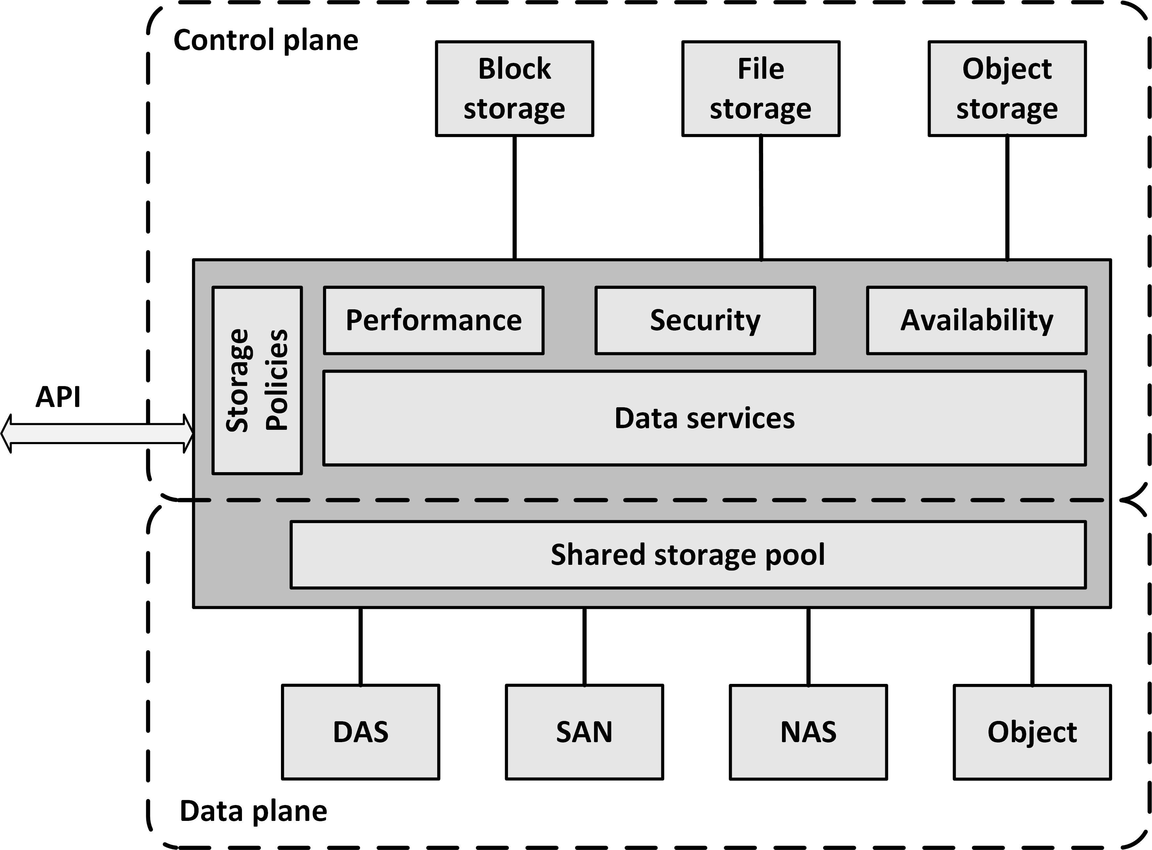
Software Defined Storage
Software Defined Storage (SDS) abstracts data and storage capabilities (also known as the control plane) from the underlying physical storage systems (the data plane)

Slide 10
Software Defined Storage
SDS virtualizes all physical storage into one large shared storage pool
Data can be stored in a variety of storage systems while being presented and managed as one storage pool to the servers consuming the storage
Storage can be implemented as software running on commodity x86-based servers with direct attached disks
Physical storage can also be a SAN, a NAS, or an Object storage system

Slide 11
Software Defined Storage
From the shared storage pool, software provides data services like:
Deduplication
Compression
Caching
Snapshotting
Cloning
Replication
Tiering

Slide 12
Software Defined Storage
SDS provides servers with virtualized data storage pools
With the required performance, availability and security
Delivered as block, file, or object storage
Based on policies
Example:
A newly deployed database server can invoke an SDS policy that mounts storage configured to have its data striped across a number of disks, creates a daily snapshot, and has data stored on tier 1 disks
APIs can be used to provision storage pools and set the availability, security and performance levels of the virtualized storage
Using APIs, storage consumers can monitor and manage their own storage consumption

Slide 13
Storage availability

Slide 14
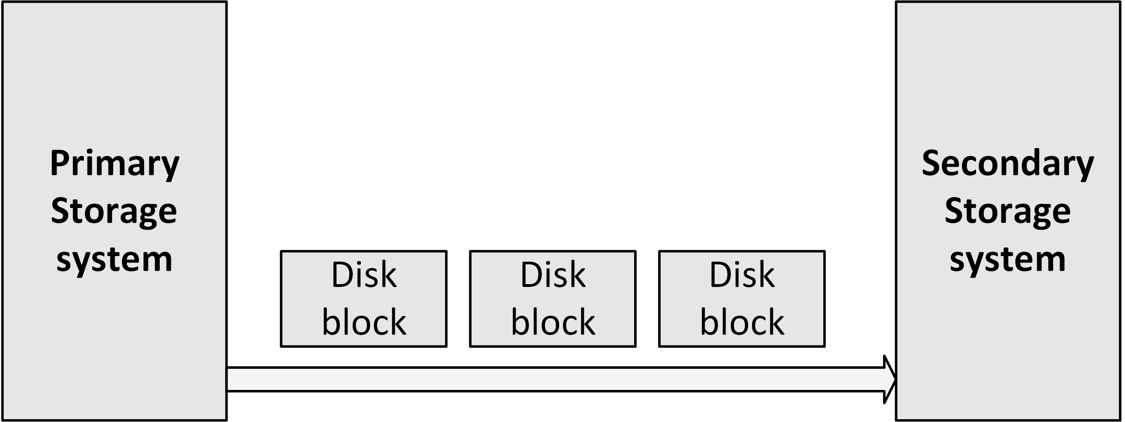
Redundancy and data replication
To increase availability in a SAN, components like HBAs and switches can be installed redundantly
Using multiple paths between HBAs and SAN switches, failover can be instantiated automatically when a failure occurs
Multiple storage systems can be used. Using replication, changed disk blocks from the primary storage system are continuously sent to the secondary storage system, where they are stored as well

Slide 15
Redundancy and data replication
Synchronous replication:
Each write to the active storage system and the replication to the passive storage system must be completed before the write is confirmed to the operating system
Ensures data on both storage systems is synchronized at all times and data is never lost
When the physical cable length between the two storage systems is more than 100 km, latency times get too long, slowing down applications, that have to wait for the write on the secondary storage system to finish
Risk: a failing connection between both storage systems a write is never finished, as the data cannot be replicated. This effectively leads to downtime of the primary storage system

Slide 16
Redundancy and data replication
Asynchronous replication:
After data has been written to the primary storage system, the write is immediately committed to the operating system, without having to wait for the secondary storage array to finish its writes as well
Asynchronous replication does not have the latency impact that synchronous replication has
Disadvantage: potential data loss when the primary storage system fails before the data has been written to the secondary storage system

Slide 17
Backup and recovery
Backups are copies of data, used to restore data to a previous state in case of data loss, data corruption or a disaster recovery situation
Backups are always a last resort, only used if everything else fails, to save your organization in case of a disaster
A well-designed system should have options to repair incorrect data from within the system or by using systems management tools (like database tools)

Slide 18
Backup and recovery
In general, backups should not be kept for a long time
Because the data copies are only relevant in the event of a disaster, organizations will typically have little use to restore a data backup that is more than a few weeks old
Restoring a backup takes you back in time
Like a time machine, but without the rest of the world – like your business partners and customers – going back in time as well

Slide 19
Backup and recovery
A common mistake is to mix up backup with archiving
Backup is about protection against data loss
Archiving deals with long term data storage, in order to comply with law and regulations
Backups should not be used to view the status of information from the past
It should be possible to retrieve these statuses from the system itself
No data should ever be deleted in a typical production system
Older data could be archived to a secondary system or database

Slide 20
Backup and recovery
Backups need to be made at a regular basis
Usually daily
Sometimes more often – every hour, or even continuously in highly critical environments
3-2-1 rule:
Keep three copies of your data
on two different media types
with one copy stored at a separate location

Slide 21
Backup and recovery
Backups must be available at a secondary site for restore
Experience with real world disasters shows it is good practice to have a distance of at least 5 km between the main site and the backup data
Apart from application data, a copy must be available on the secondary site of:
Operating system installation disks
Printed procedures on how to build up a new system using the backups
License keys of the software (including the restore software)

Slide 22
Backup and recovery
Test the restore procedure at least once a year to ensure restores work as planned
Include building up new hardware
Have restore procedures tested by a third party, or at least by people that have not performed a restore before
In case of a real disaster we cannot assume that systems managers are able to restore data again
Restore tests should be performed each month to ensure backup media still work as expected
Restore some files
Do the tapes really contain the expected data?

Slide 23
Backup schemes
A backup scheme describes what data is backed-up, when, and how
Backup schemes can become very complex in large environments with many applications
Four basic backup schemes

Slide 24
Backup schemes
Full backup
A complete copy of all data
Full backups are only created at relatively large intervals (like a week or a month)
Creating them takes much time, disk or tape space, and bandwidth
Restoring a full backup takes the least amount of time

Slide 25
Backup schemes
Incremental backup
Save only newly created or changed data since the last backup, regardless of whether it is a previous incremental backup or a full backup
Restoring an incremental backup can take a long time
Especially when the last full backup is many incremental backups ago

Slide 26
Backup schemes
Differential backup
Save only newly created or changed data since the last full backup
Restoring a differential backup is quite efficient, as it implies restoring a full backup and only the most recent differential backup

Slide 27
Backup schemes
Continuous Data Protection (CDP)
Guarantees that every change in the data is also simultaneously made in the backup system
The RPO (Recovery Point Objective) is set to zero, because each change immediately triggers a backup process
Expensive technology, and therefore only used in specific situations

Slide 28
Backup data retention time
Backup data retention time is the amount of time in which a given set of data will remain available for restore
Defines how long backups are kept and at which interval
In practice, a Grandfather-Father-Son (GFS) based schedule is often used:
Each day a backup is made
After a week, there are seven backups, of which the oldest backup is renamed to a weekly backup
After the second week, the same is done and the daily backups of the week before are deleted
Now there are eight backups: seven daily, two weekly
Every four weeks, the weekly backup is renamed as a monthly backup and the weekly backups are reused
The daily backups are the son, the weekly backups are the father, and the monthly backups are the grandfather

Slide 29
Archiving
Archiving is mostly done for compliancy and regulation reasons
Example:
US regulations require all medical records to be retained for 30 years after a person's death
This means that X-rays taken when a child was born must be kept for as much as 130 years!
Noncompliance to law and regulation can lead to serious business disruption, fines, and even jail time

Slide 30
Archiving
Archived data is read-only to protect it from being altered
Very important for regulatory compliance and non-repudiation
Some archiving systems store data in an encrypted form and use digital signatures to prove data is not tampered with
Some systems allow data to be written to it for archiving, but disallow changing or deleting data
CD / DVD/ Blu-ray
WORM tapes

Slide 31
Archiving
Data must be kept in such a way that it is guaranteed the data can be read after a long time
Digital format (like a Microsoft Word file or a JPG file)
Physical format (like a DVD or a magnetic tape)
Storage environment (temperature, humidity)
Use open standards for storing archived data
Open standards are well documented
Reading data will always be feasible, using emulation software if needed
Storing all documents in structured human-readable XML text files is one way to ensure data can be read for many decades
Transfer data that is to be kept for a long time to the latest storage media standard every 10 years

Slide 32
Storage performance

Slide 33
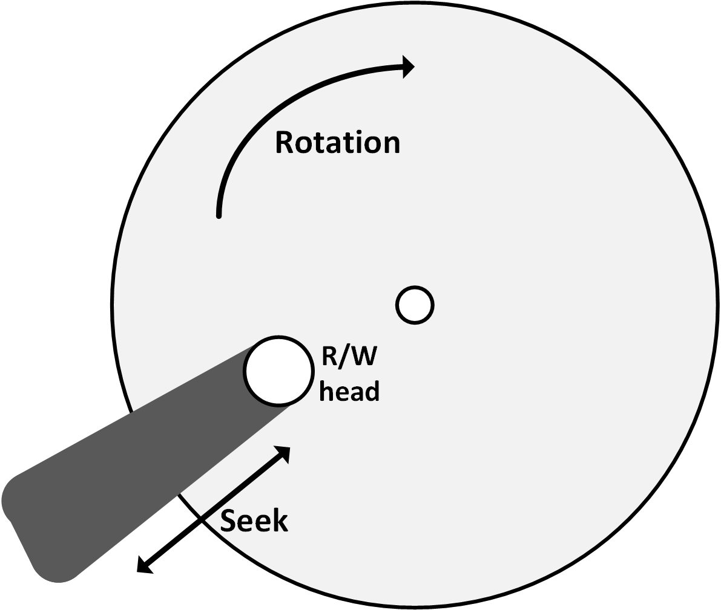
Disk performance
Disk performance is dependent on:
Disk rotation speed
Seek times
Interface protocol
Some common examples of rotation delay:

Slide 34
Disk performance
Disks cannot spin much faster than 15,000 RPM
At this speed the velocity at the edge of a 3.5” disk is 250 km/h!
Increasing this velocity would physically destroy the disk
Seek time is the time it takes for the head to get to the right track
Average seek times:
3 ms for high-end disks
9 ms for low-end disks

Slide 35
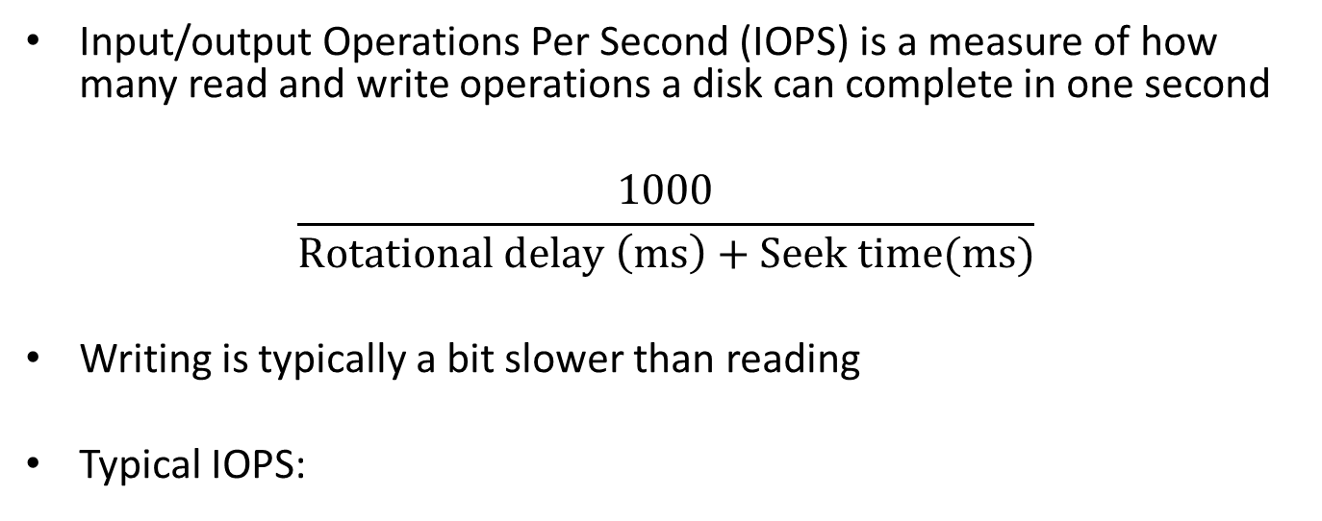
IOPS
Input/output Operations Per Second (IOPS) is a measure of how many read and write operations a disk can complete in one second
$$\frac{1000}{Rotational delay \left(ms\right)+Seek time(ms)}$$
Writing is typically a bit slower than reading
Typical IOPS:

Slide 36
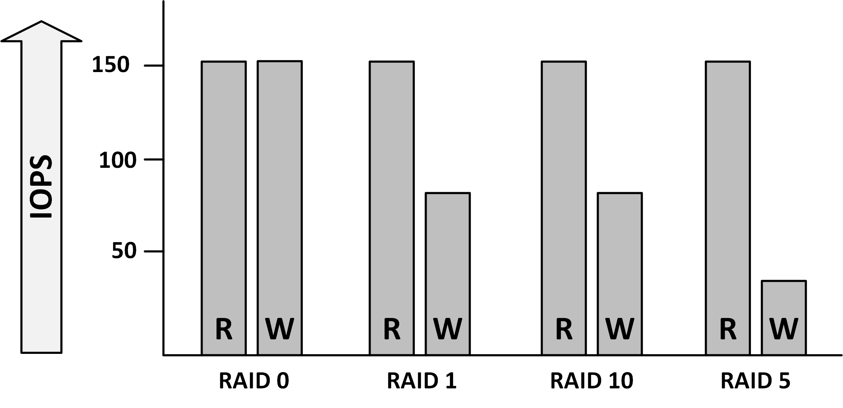
RAID penalty
In RAID sets multiple disks are used to form one virtual disk (LUN)
Writing data on multiple disks introduces some delay, known as the RAID penalty

Slide 37
Interface throughput
Storage performance is also dependent on how fast the interface can move data from the disks to the systems consuming the data and vice versa
An overview of the various interface speeds:

Slide 38
Caching
A caching system in disk controllers can improve performance by several orders of magnitude
Read-cache acts as a buffer for reads. When the same data is read multiple times, it is served from cache
Write-through cache: data is written to cache and then to disk, and only acknowledged as written when the data is physically written on the disk
Write-through cache: allows the disk controller to acknowledge the data as written as soon as it is held in cache. This allows the cache to buffer writes quickly and then write the data to the slower disk when the disk is ready to accept new I/O operations
The type and amount of cache needed depends on what applications need
A web server, for instance, will mostly benefit from read-cache, whereas most databases are better off with write cache

Slide 39
Storage tiering
Tiered storage creates a hierarchy of storage media, based on cost, performance requirements, and availability requirements
Example:
Tier 1: Production data (SSD and SAS disks)
Tier 2: Seldom used data, like email archives (NL-SAS disks)
Tier 3: Backups (Virtual Tape Libraries on NL-SAS disks)
Tier 4: Archived data (Tape or NL-SAS disks)
The more tiers are used, the more effort it takes to manage the tiers
Automated tiering usually checks for file access times, file creation date, and file ownership, and automatically moves data to the storage medium that fits best

Slide 40
Load optimization
Storage performance is highly dependent on the type of load
Most vendors recommend a specific storage configuration for their systems or applications
For example, Oracle recommends a combination of RAID 1 and 5 for its database in order to optimize performance

Slide 41
Storage security

Slide 42
Protecting data at rest
Data can be:
In transit (transported over a network)
In use (by an application or a cache)
At rest (on a disk or a tape)
Data at rest can be secured using encryption techniques
Prevent reading or writing data to disk or tape without the correct encryption/decryption key
Disk encryption in the datacenter has limited benefits:
Databases and applications need to work with unencrypted data to perform useful work
Disk encryption is only useful when the disks are physically lost or stolen (laptops, desktops, or removable media)
Disks in the datacentre are in a physically secure area

Slide 43
Protecting data at rest
Disk encryption in the datacenter is useful:
A disk drive might get in the wrong hands – for instance because it was removed after it was marked "faulty" and was never destroyed
In case of disk failure, having the data encrypted solves the issue of having potentially sensitive data on a disk that can't be accessed anymore, as it is defective
Maintenance contracts often require that a failed disk must be sent back to the vendor after replacing it with a new one. Without disk encryption, returning disks may not be possible since a failed disk cannot be erased anymore.
Full disk encryption makes it harder for an attacker to retrieve data from the "empty" space on the disks, which often contains traces of previously stored data.

Slide 44
Protecting data at rest
Self-Encrypting Drives (SEDs):
Use in laptops and desktops
When an SED is powered up, authentication is required to access data – the user must type in a password to start the boot sequence of the computer
Encryption is built into the disk drive’s hardware
Encryption keys are stored on the disk
Cryptographic Disk Erasure (CDE):
Deletes the encryption key on the disk
This has the same effect as erasing all disk contents
Without the key, unencrypted data can no longer be read from the disk
One of the best ways to fully wipe a disk’s contents

Slide 45
SAN zoning
SAN zoning is a method of arranging Fibre Channel devices into logical groups on a SAN fabric for security purposes
SAN zoning is implemented in the SAN switches
SAN zones are comparable with VLANs in Ethernet networks
Fibre Channel devices can only communicate with each other if they are members of the same zone

Slide 46
SAN LUN masking
In a SAN, LUN masking makes a LUN available to some hosts and unavailable to other hosts
LUN masking is implemented primarily at the HBA level, not in the SAN switches
It is good practice to use a combination of SAN zoning and LUN masking

